Slide 1
Structured Programming Language ICT 1103
Nahidul Islam
Lecturer, Dhaka City College
Dhanmondi, Dhaka
1

Slide 2
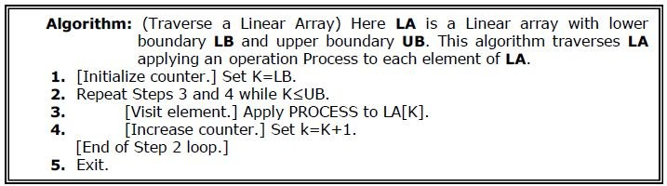
Traversing in Linear Array
It means processing or visiting each element in the array exactly once;
Let ‘A’ is an array stored in the computer’s memory. If we want to display the contents of ‘A’, it has to be traversed
i.e. by accessing and processing each element of ‘A’ exactly once.

Slide 3
Sorting in Linear Array
Sorting an array is the ordering the array elements in ascending (increasing - from min to max) or descending (decreasing – from max to min) order.
Example:
{2 1 5 7 4 3} →{1, 2, 3, 4, 5,7} ascending order
{2 1 5 7 4 3} →{7,5, 4, 3, 2, 1} descending order

Slide 4
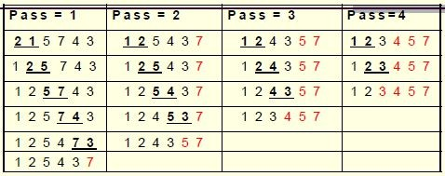
Bubble Sort
Example:
This sorting algorithm is comparison based algorithm in which each pair of adjacent elements is compared and elements are swapped if they are not in order.

Slide 5
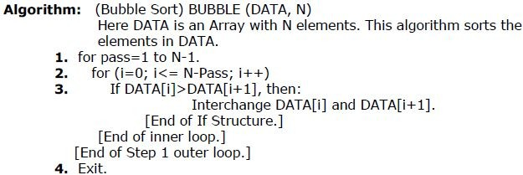
Bubble Sort

Slide 6
#include <stdio.h> int main()
{
int data[100],i,n,step,temp;
printf("Enter the number of elements to be sorted: "); scanf("%d",&n);
for(i=0;i<n;++i)
{ printf("%d. Enter element: ",i+1); scanf("%d",&data[i]);
}
for(step=1;step<n;++step) for(i=0;i<n-step;++i)
{
if(data[i]>data[i+1])
{
temp=data[i]; data[i]=data[i+1]; data[i+1]=temp;
}
}
printf("In ascending order: "); for(i=0;i<n;++i)
printf("%d ",data[i]); return 0;
Bubble
sort
6

Slide 7
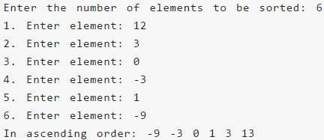
Bubble Sort
Output of previous program:

Slide 8
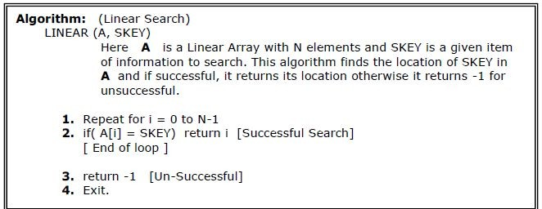
Searching in Linear Array
Linear Search:
The linear search compares each element of the array with the search key until the search key is found. To determine that a value is not in the array, the program must compare the search key to every element in the array.

Slide 9
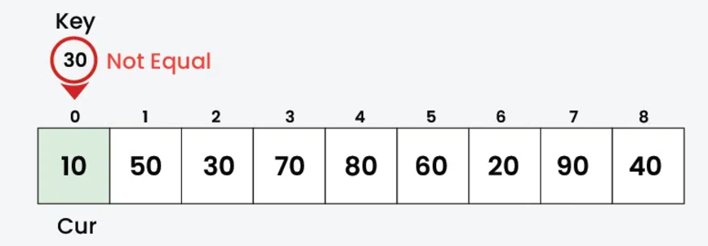
Linear Search
In Linear Search, we iterate over all the elements of the array and check if it the current element is equal to the target element. If we find any element to be equal to the target element, then return the index of the current element. Otherwise, if no element is equal to the target element, then return -1 as the element is not found. Linear search is also known as sequential search.
arr[] = {10, 50, 30, 70, 80, 20, 90, 40} and key = 30

Slide 10
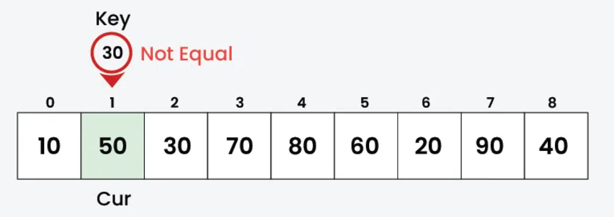
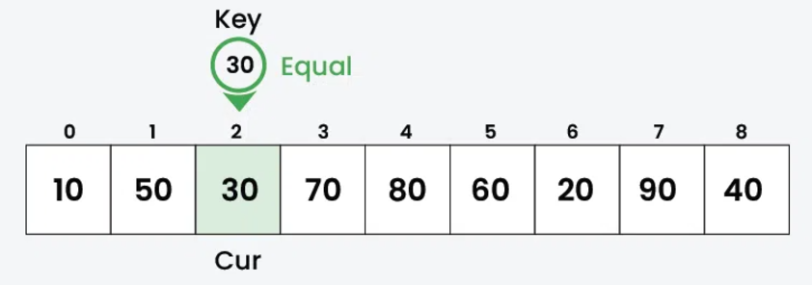
Continue…

Slide 11
Binary Search
It is useful for the large sorted arrays. The binary search algorithm can only be used with sorted array and eliminates one half of the elements in the array being searched after each comparison.

Slide 12
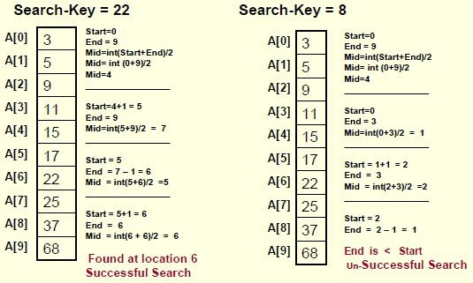
Binary Search
Example:

Slide 13
int main()
{
int c, first, last, middle, n, search, array[100]; printf("Enter number of elements\n");
scanf("%d", &n);
printf("Enter %d integers\n", n); for (c = 0; c < n; c++)
scanf("%d", &array[c]); printf("Enter value to find\n"); scanf("%d", &search);
first = 0; last = n - 1;
middle = (first+last)/2; while (first <= last) {
if (array[middle] < search) first = middle + 1;
else if (array[middle] == search) {
printf("%d found at location %d.\n", search, middle+1);
break;
}
else
last = middle - 1; middle = (first + last)/2;
}
if (first > last)
printf("Not found! %d isn't present in the list.\n", search); return 0;
}

Slide 14
// Binary Search in C using user defined function
#include <stdio.h>
int binarySearch(int array[], int x, int low, int high) { while (low <= high) {
int mid = low + (high - low) / 2;
if (array[mid] == x) return mid;
if (array[mid] < x) low = mid + 1;
else
high = mid - 1;
}
return -1;
}
int main(void) {
int array[] = {3, 4, 5, 6, 7, 8, 9};
int n = sizeof(array) / sizeof(array[0]); int x = 4;
int result = binarySearch(array, x, 0, n - 1); if (result == -1)
printf("Not found");

Slide 15
Thank you
14

